Slide 1
Kafka Command-Line Interface tools

Slide 2
Kafka CLI
The Kafka Command Line Interface (CLI) is a set of command-line tools provided by Apache Kafka to interact with and manage Kafka clusters and resources. These tools offer a convenient way for administrators, developers, and operators to perform various tasks related to Kafka topics, consumers, producers, and brokers from the command line.
Installation: First, you need to install Apache Kafka on your system. The Kafka distribution includes the CLI tools by default, so you don't need to install them separately.
Environment Setup: To use the Kafka CLI tools, you typically need to set up environment variables, such as specifying the location of the Kafka installation, configuring the Kafka server(s) you want to connect to, and other relevant settings. These environment variables are used by the CLI tools to establish connections and determine the target Kafka cluster.

Slide 3
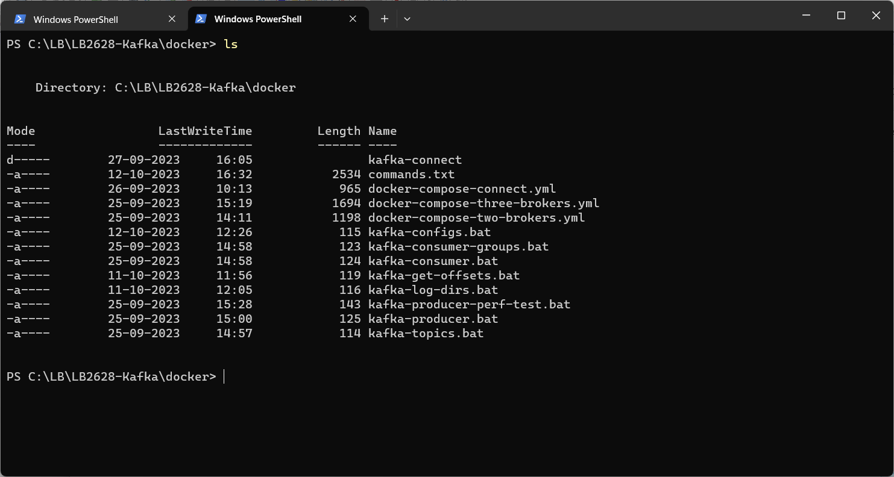
Exercise
Introduction to CLI scripts
Scripts are running in containers
Producers
Consumers, consumer-groups
Topics
3.1

Slide 4
Kafka-topics
This tool allows you to create, list, describe, delete, and modify Kafka topics.
// List all topics
kafka-topics --list
// Create a new topic with 3 partitions
kafka-topics --create --topic my-topic --partitions 3
// Show details about the topic
kafka-topics --describe --topic my-topic
// Delete the topic
kafka-topics --delete --topic my-topic

Slide 5
kafka-consumer-groups
Use this tool to manage Kafka consumer groups, list consumer group details, and monitor consumer group offsets.
// List all groups
kafka-consumer-groups –list
// Show details of a group
kafka-consumer-groups --describe --group my-group
// Create group with offsets set to earliest
kafka-consumer-groups --create --group my-group --to-earliest

Slide 6
Kafka-console-producer
Useful tool to publish messages to a Kafka topic from the command line.
//Start a producer to publish messages to the "my-topic" topic.
kafka-console-producer --topic my-topic
//Option to specify key & value.
kafka-console-producer --topic my_topic --property parse.key=true --property key.separator=":”

Slide 7
Kafka-console-consumer
Useful tool that allows you to consume and print messages from a Kafka topic in real-time.
// Start a consumer to read messages from the "my-topic" topic from beginning.
kafka-console-consumer --topic my-topic –from-beginning
// Consume messages from the "my-topic" as part of the group my-group.
kafka-console-consumer --topic my-topic –group my_group
// Consume messages from the "my-topic“, print the key and specify a deserializer.
kafka-console-consumer --topic my-topic --property print.key=true --value-deserializer "org.apache.kafka.common.serialization.LongDeserializer“
Other useful properties:
--property print.partition=true --property print.offset=true

Slide 8
Kafka-producer-perf-test
This tool is used for performance testing and benchmarking Kafka producers.
It allows you to simulate the production of a large number of messages to measure Kafka producer performance.
//Perform a producer performance test.
kafka-producer-perf-test --topic my-topic --throughput 10 --num-records 1000
--record-size 10

Slide 9
Kafka-configs
Allows users to manage and manipulate configuration settings for Kafka brokers, topics, and other Kafka components. It is particularly useful for changing configuration parameters dynamically without the need to restart Kafka brokers or other Kafka components
// Describe all topics
kafka-configs.bat --entity-type topics --entity-name streams-out-1 --describe
// describe broker with id 1
kafka-configs.bat --entity-type brokers --entity-name 1 --describe --all

Slide 10
Kafka-get-offsets
This tool allows you the partition offsets for one or more topics
// Shows all topics and their partitions with offsets
kafka-get-offsets.bat --topic my-topic
// Shows all partitions and their offsets for topic my-topic
kafka-get-offsets.bat --topic my-topic

Slide 11
Kafka-log-dirs
Allows user to query a list of replicas per log directory on a broker. The tool provides information that is required for optimizing replica assignment across brokers.
kafka-log-dirs.bat --topic-list my-topic --describe

